Slide 1
Greek and Hellenistic Religion

Slide 2
History
Syncretism
Minoan- island of Crete
Minyans- on the mainland
Dorians- invading force
Dark Age

Slide 3
Early Religion
Fertility goddess
Emphasis on life, death, rebirth (life cycle)
  butterflies
Sacrifices
Theriomorphic
Immortality
Animism (chthonioi- agricultural deities)
Local deities
Funerals
No canon of sacred myths

Slide 4
Olympian Pantheon
Polytheistic gods and goddesses residing on the top of Mount Olympus
Anthropomorphic
Patriarchal
Homer
Zeus
Centrality of Sky phenomena
Largely oral

Slide 5
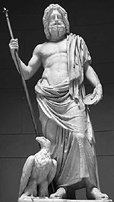
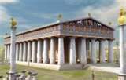
Zeus King of gods

Slide 6
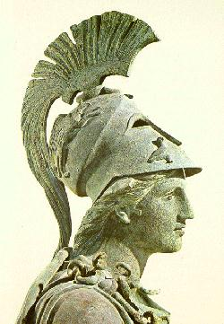
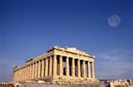
Athena goddess of war/wisdom
Parthenon

Slide 7
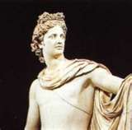
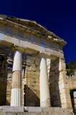
Apollo god of reason

Slide 8
Olympian Pantheon (continued)
Sacred is present and forbidden to touch
3 categories of people: priests, warriors, commoners
Oracles
  Oracle at Delphi (Apollo)
  Pilgrimage
Older Mystery Cults
  Proselytizing
  Secrecy

Slide 9
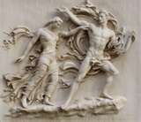
Older Mystery Cults
Orphics
  Focuses on the underworld
  Orpheus
  Eurydice
  Soul is immortal but the body is its tomb
  Reincarnation to suffering
  Strict moral codes
  500 BCE
  Appealed to persons of refinement
  Sacred book

Slide 10
Older Mystery Cults
Pythagoreans
  6th century BCE
  Secret knowledge as precise as geometry
  Soul is immortal
  Reincarnation
  Ascetic life
  Vegetarianism

Slide 11

Older Mystery Cults
Dionysians
  Dionysus- god of vegetation and wine
  Irrational and emotional
  Popular among married women

Slide 12
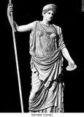
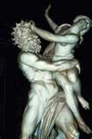
Older Mystery Cults
Eleusinians
  Demeter (goddess of grain)
  Persephone
  Hades (god of underworld)
  Explains cycle of harvest and winter
  Common ideas of immortality, fertility,
  death
  Secret knowledge
  Survived for about 2,000 years
  Appealed to all social classes

Slide 13
Greek Philosophy
Love of wisdom
Aristocratic elite
Philosophers
  Thales
  Heraclitus
  Eleatics (Xenophanes)- monistic pantheism
  Empedocles
  Sophists

Slide 14
Greek Philosophy
Socrates
  Socratic Method
  Groups that rise after his death
    Cyrenaics- hedonism
    Cynics- Diogenes
Plato
  Dualism
  The Forms
  Immortal
  Myth of the Cave

Slide 15
Greek Philosophy
Aristotle
  Logic
  Golden mean
Epicureans
  No immortality of the soul
Stoics- Zeno

Slide 16
The Hellenistic Mystery Cults
Alexander the Great (332-329 BCE is beginning of Hellenistic period)
Hellenism
Syncretism
Middle Eastern deities come to Greece
Brought the mother goddess (this may be connected to Mary the mother of Jesus in the early Christian Church)

Slide 17
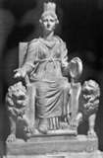
The Hellenistic Mystery Cults
Cybele (200BCE)
  Comes from Phrygia (Turkey)
  Identified with Rhea
  Mistress of animals
  Attis
  Vengeful goddess
  Patroness of life and defender of women
  Rituals
  Popular religion

Slide 18

The Hellenistic Mystery Cults
Isis
  From Egypt (1st century CE)
  Serapis
  Heavenly queen of the elements, ruler of the stars and planets
  Theistic
  High code of ethics
  Ritual bathing

Slide 19
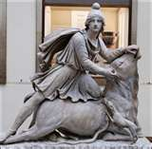
The Hellenistic Mystery Cults
Mithraism
  Mithra
  Iran (2nd century CE)
  Popular among Roman soldiers
  Sacrifice of bull for fertility
  Secret rituals
  December 25
  Ran underground “churches” and schools
  Males only

Slide 20
Worldview
Nature and divinity are together
Fertility
purification

